Slide 1


Jennifer Selby
September 7th 2023

Slide 2

Outline
Executive Summary
Introduction
Methodology
Results
Conclusion

Slide 3
Executive Summary
Summary of methodologies
Data collection
Data wrangling
EDA with data visualization
EDA with SQL
Interactive map with Folium
Dashboard with Plotly Dash
Predictive analysis
Summary of all results
Increased launch success rate is positively correlated with
Increased number of flights for a given launch site
Decreased payload mass
Increased instances of ES-L1, GEO, HEO and SSO orbits
Flights occurring from 2013 to 2022
Successful prediction of launch outcome is most positively correlated with
Use of the decision tree machine learning algorithm
Main challenge is false positives: unsuccessful predicted as successful

Slide 4
Introduction
Project Background and Context
Public companies are decreasing the cost of space travel
Examples include
Virgin Galactic
Rocket Lab
Blue Origin
SpaceX
The cost to launch a SpaceX rocket is significantly lower compared its competitors
This is in part due to SpaceX’s ability to reuse the first stage rocket

Slide 5
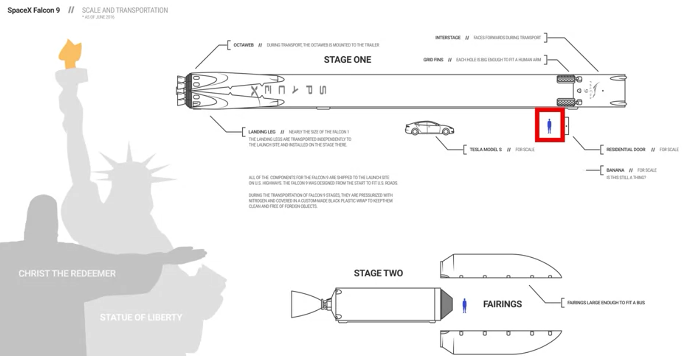
Introduction
Problems to Solve
The purpose of this report is to explore the cost of each SpaceX rocket launch by determining whether the first stage is reused
Information was gathered regarding SpaceX and dashboards created
Machine learning models and public information were used to predict whether SpaceX will reuse the first stage and successfully land the rocket

Slide 6

Section 1

Slide 7
Methodology
Executive Summary
Data collection methodology:
Data was collected using SpaceX API and web scraping
Perform data wrangling
One-hot encoding was applied to categorical features
Perform exploratory data analysis (EDA) using visualization and SQL
Perform interactive visual analytics using Folium and Plotly Dash
Perform predictive analysis using classification models
How to build, tune, evaluate classification models

Slide 8
Data Collection
SpaceX launch data was obtained from the SpaceX REST API and includes data regarding
Launches
Rocket used
Payload delivered
Launch specifications
Landing specifications
Landing outcome

Slide 9
Data Collection
The specific endpoint api.spacexdata.com/v4/launches/past was used to get past launch data
The requests library was used to preform a get request
The results were viewed by calling the .json() method
Response is a list of JSON objects, each of which represents a launch
JSON was converted to a dataframe using the json_normalize function
This normalizes the structured json data into a flat table

Slide 10
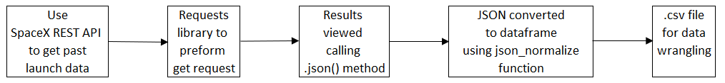
Data Collection – SpaceX API
https://github.com/selb76143/testrepo/blob/main/jupyter-labs-spacex-data-collection-api.ipynb

Slide 11
Data Collection
The Python BeautifulSoup package was also used to web scrap HTML tables that contain Falcon 9 launch records
The data from the tables was then converted into a Pandas data frame
Some columns like rocket contain an identification number as opposed to data
The API was then used to target another endpoint to gather data for each ID Number
This data was stored in lists and was used to create the dataset
The data obtained contained data from the Falcon 1 booster which was removed so that only data from the Falcon 9 data remained
The mean of the payload mass was calculated, and the null payload mass values were replaced with the mean
Null values were left for the landing pad column as this represented the situation where a landing pad was not used

Slide 12
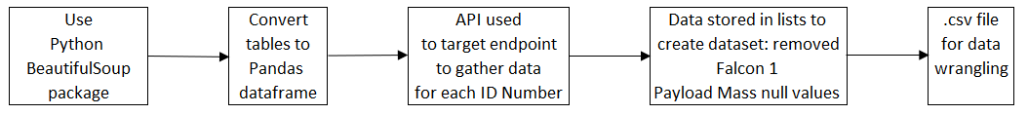
Data Collection - Scraping
https://github.com/selb76143/testrepo/blob/main/jupyter-labs-webscraping.ipynb

Slide 13
Data Wrangling
Data attributes were reviewed
Examples include: LaunchSite, Orbits, ASD (landing outcome) .
The following was then preformed
Calculate the number of launches on each site
Calculate the number and occurrence of each orbit
Calculate the number and occurrence of mission outcome per orbit type
Landing outcome was then converted to Class Y: 1 or 0
1: successful landing
0: unsuccessful landing

Slide 14
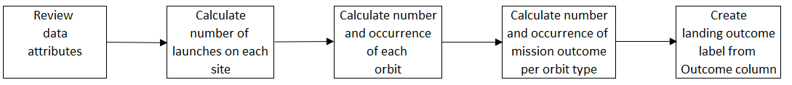
Data Wrangling
https://github.com/selb76143/testrepo/blob/main/labs-jupyter-spacex-data_wrangling_jupyterlite.jupyterlite.ipynb

Slide 15
EDA with Data Visualization
Chart Summary
Flight Number vs PayloadMass with Outcome
FlightNumber vs LaunchSite with Outcome
Payload Mass vs LaunchSite
Bar Chart: Success rate of each orbit
Flight Number and PayloadMass vs Orbit Type
Yearly Trend: Launch Success
https://github.com/selb76143/testrepo/blob/main/IBM-DS0321EN-SkillsNetwork_labs_module_2_jupyter-labs-eda-dataviz.ipynb.jupyterlite.ipynb
These plots were created to explore the data set and investigate the parameters which are positively and negatively correlated with launch success

Slide 16
EDA with SQL
SQL queries performed
Total payload mass carried by boosters
Average payload mass carried by booster version F9 v1.1
Date when the first successful landing outcome in ground pad was achieved
Names of the boosters which have success in drone ship and have payload mass greater than 4000 but less than 6000
Total number of successful and failure mission outcomes
Names of the booster_versions which have carried the maximum payload mass.
Records which will display the month names, failure landing_outcomes in drone ship, booster versions, launch_site for the months in year 2015
Rank the count of landing outcomes
https://github.com/selb76143/testrepo/blob/main/jupyter-labs-eda-sql-coursera_sqllite.ipynb

Slide 17
Interactive Map with Folium
All launch sites on a were plotted on a map
Instances of successful launches per site were plotted on a map
Proximity of the launch sites to local infrastructure was determined
https://github.com/selb76143/testrepo/blob/main/IBM-DS0321EN-SkillsNetwork_labs_module_3_lab_jupyter_launch_site_location.jupyterlite.ipynb
The date was plotted on a map to explore the correlation between launch site and geographic location and proximity to local infrastructure

Slide 18
Dashboard with Plotly Dash
Plots/graphs and interactions
Launch Site Drop-down Input Component
Success-pie-chart based on selected site dropdown
Range Slider to Select Payload
https://theiadocker-2-labs-prod-theiak8s-4-tor01.labs.cognitiveclass.ai/user/jenselby2001/#/home/project
These dashboards were created to gain insight into
Which site had the most successful launches and corresponding success rate
Relationship between payload mass and success rate

Slide 19
Predictive Analysis
Perform exploratory Data Analysis and determine Training Labels
Create a column for the class
Standardize the data
Split into training data and test data
Find the method performs best using test
https://github.com/selb76143/testrepo/blob/main/IBM-DS0321EN-SkillsNetwork_labs_module_4_SpaceX_Machine_Learning_Prediction_Part_5.jupyterlite.ipynb

Slide 20
Predictive Analysis
The data was split into training and testing data
The training data was then divided into validation data: a second set used for training data
The models were trained and hyperparameters selected
Models included
Logistic Regression
K Nearest Neighbour
Support Vector Machine
Decision Tree
The accuracy on the test data was calculated using the method score
The Confusion Matrix was then plotted

Slide 21
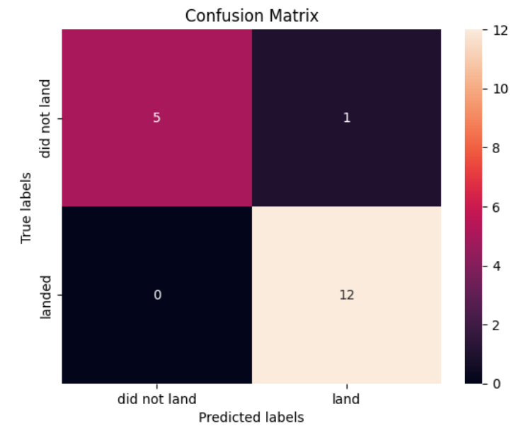
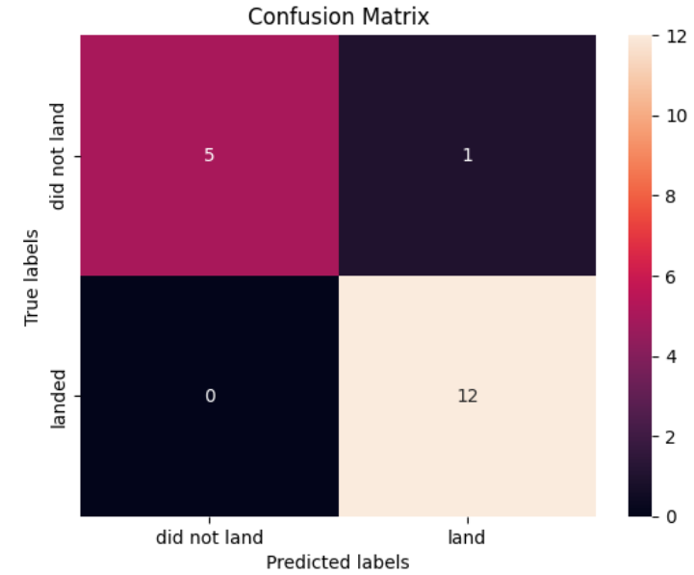
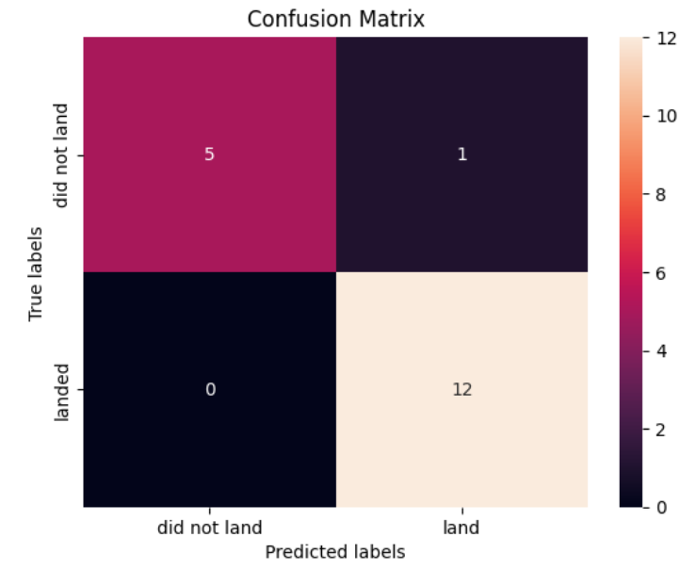
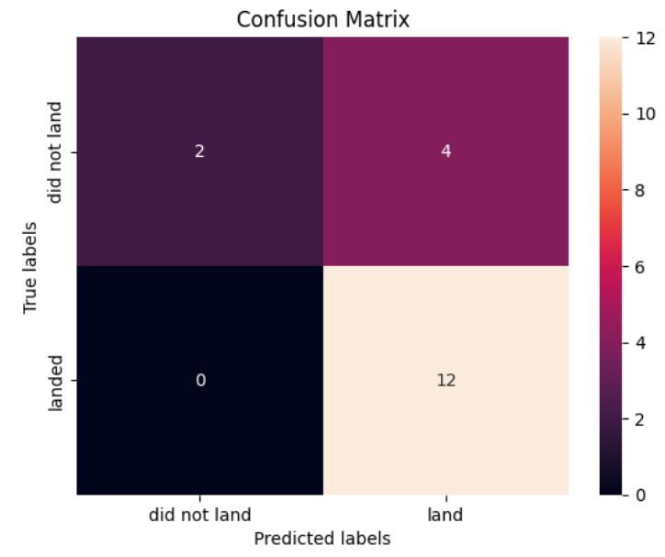
Results – LR/SVM/KNN/Decision Tree
The methodology outlined above was repeated for SVM, KNN and Decision Tree
Logistic Regression: 82.2% Accuracy | SVM: 82.2% Accuracy
KNN: 84.4% Accuracy | Decision Tree: 88.9% Accuracy

Slide 22

Section 2

Slide 23
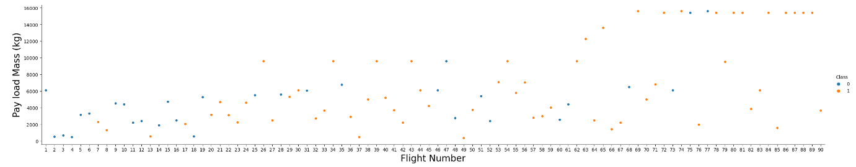
Data Visualization
Flight Number vs PayloadMass with Outcome
As the Flight Number increases, the first stage is more likely to land successfully
As PayloadMass increases, the less likely the first stage will return
https://github.com/selb76143/testrepo/blob/main/IBM-DS0321EN-SkillsNetwork_labs_module_2_jupyter-labs-eda-dataviz.ipynb.jupyterlite.ipynb

Slide 24
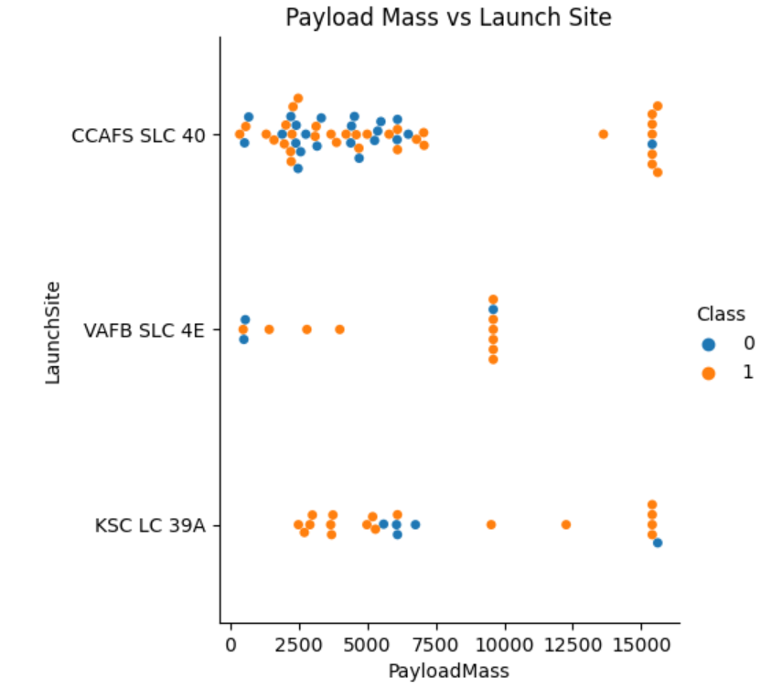
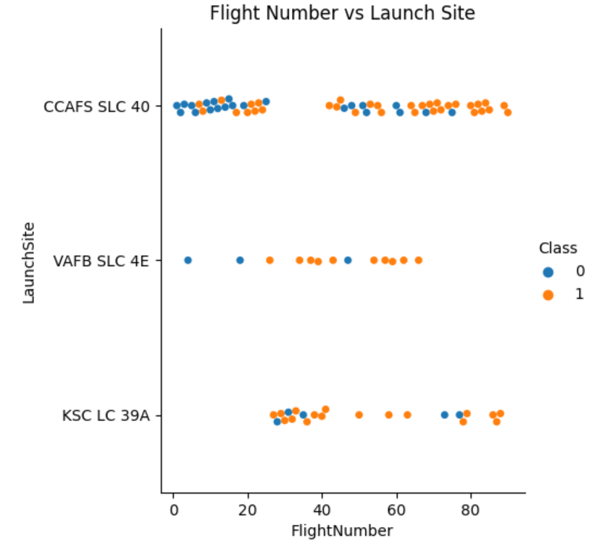
Data Visualization
FlightNumber vs LaunchSite with Outcome
CCAFS SLC 40 has highest number of launches
Payload Mass vs LaunchSite
Lower PayloadMass launched from CCAFS SLC 40

Slide 25
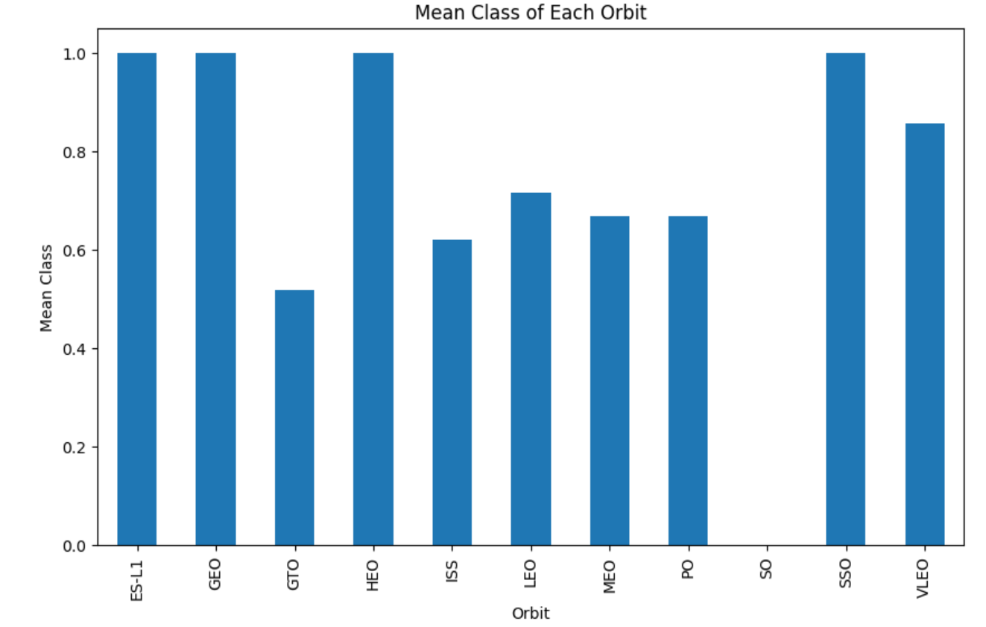
Data Visualization
Bar Chart: Success rate of each orbit
ES-L1, GEO, HEO and SSO have highest success rates

Slide 26
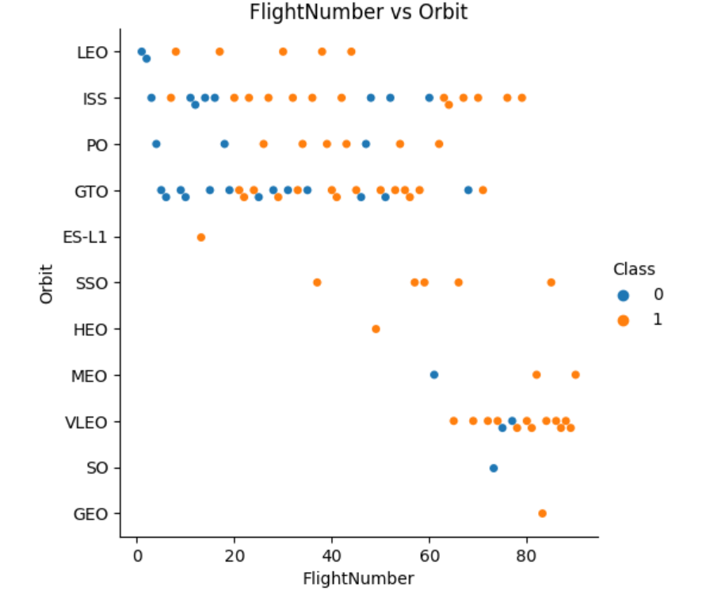
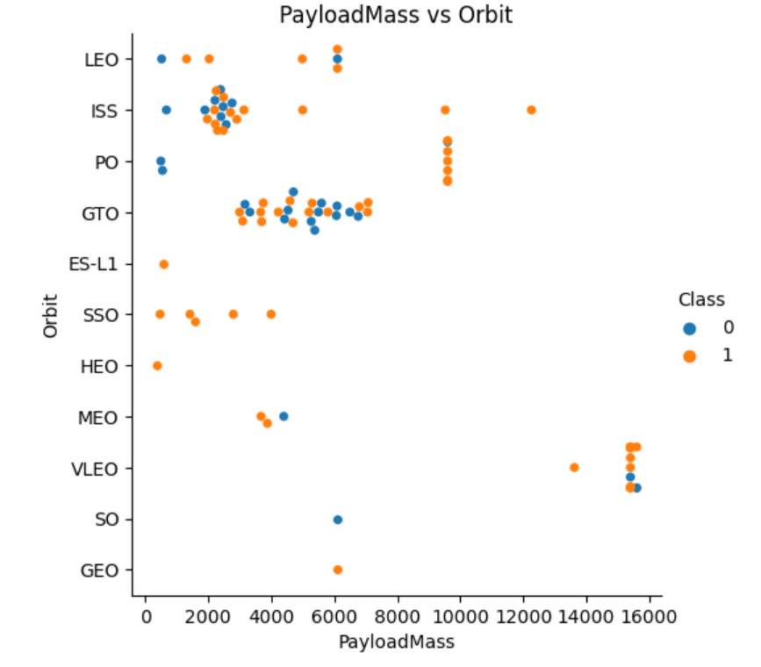
Data Visualization
Flight Number vs Orbit Type
Launches move from LEO, ISS, PO, GTO to VLEO
PayloadMass vs Orbit Type
Lower PayloadMass for LEO, ISS, PO, GTO and higher for VLEO

Slide 27
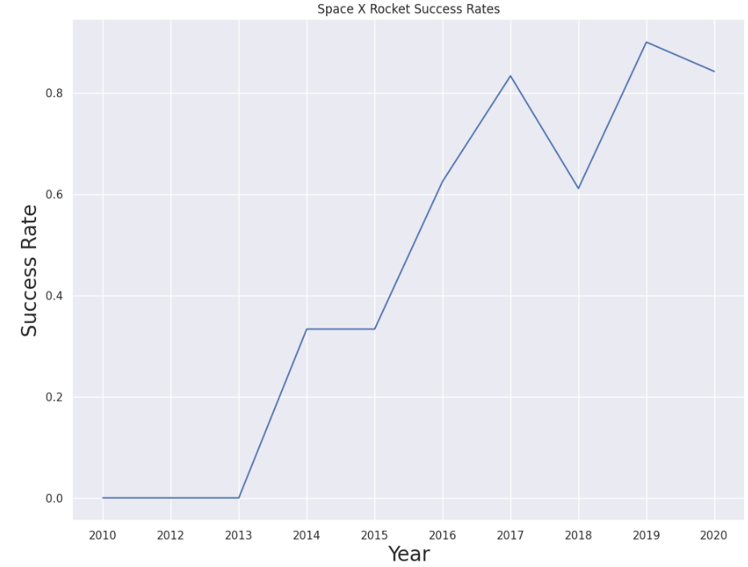
Data Visualization
Yearly Trend: Launch Success
Launch success increase since 2013

Slide 28
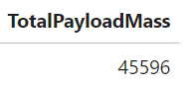
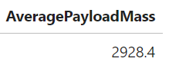
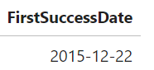
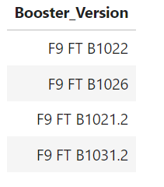
SQL
Display the total payload mass carried by boosters launched by NASA (CRS)
Display average payload mass carried by booster version F9 v1.1
List the date when the first successful landing outcome in ground pad was achieved
List the names of the boosters which have success in drone ship and have payload mass greater than 4000 but less than 6000

Slide 29
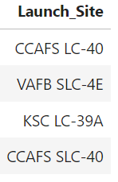
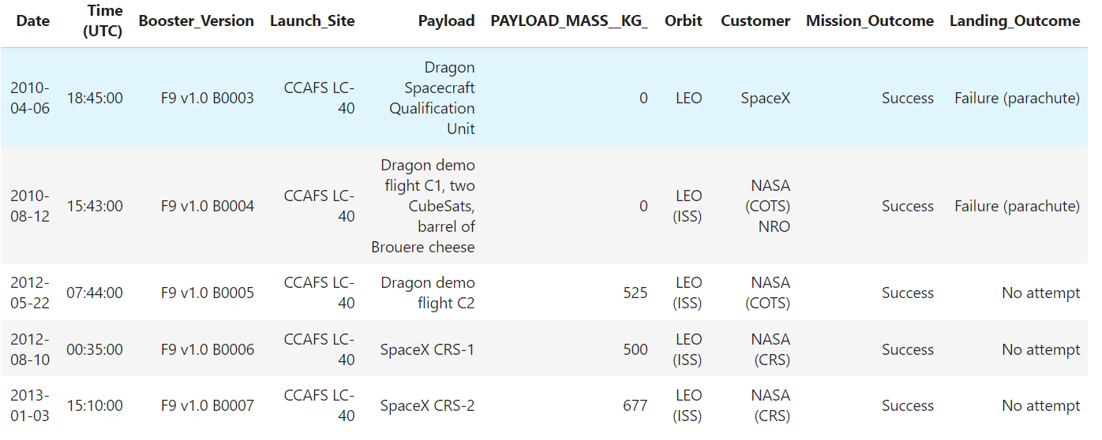
SQL
Display the names of the unique launch sites in the space mission
Display 5 records where launch sites begin with the string CCA
https://github.com/selb76143/testrepo/blob/main/jupyter-labs-eda-sql-coursera_sqllite.ipynb

Slide 30
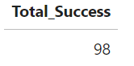
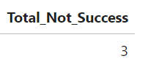
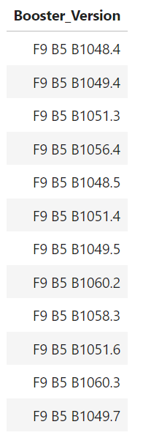
SQL
List the total number of successful and failure mission outcomes
List the names of the booster_versions which have carried the maximum payload mass. Use a subquery
List the records which will display the month names, failure landing_outcomes in drone ship ,booster versions, launch_site for the months in year 2015.

Slide 31
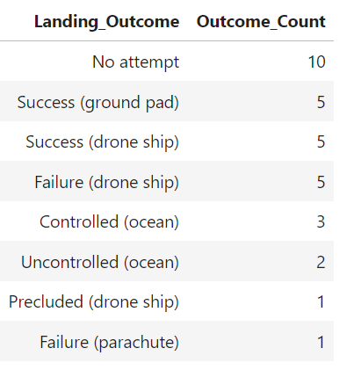
SQL
Rank the count of landing outcomes (such as Failure (drone ship) or Success (ground pad)) between the date 2010-06-04 and 2017-03-20, in descending order.

Slide 32

Section 3

Slide 33
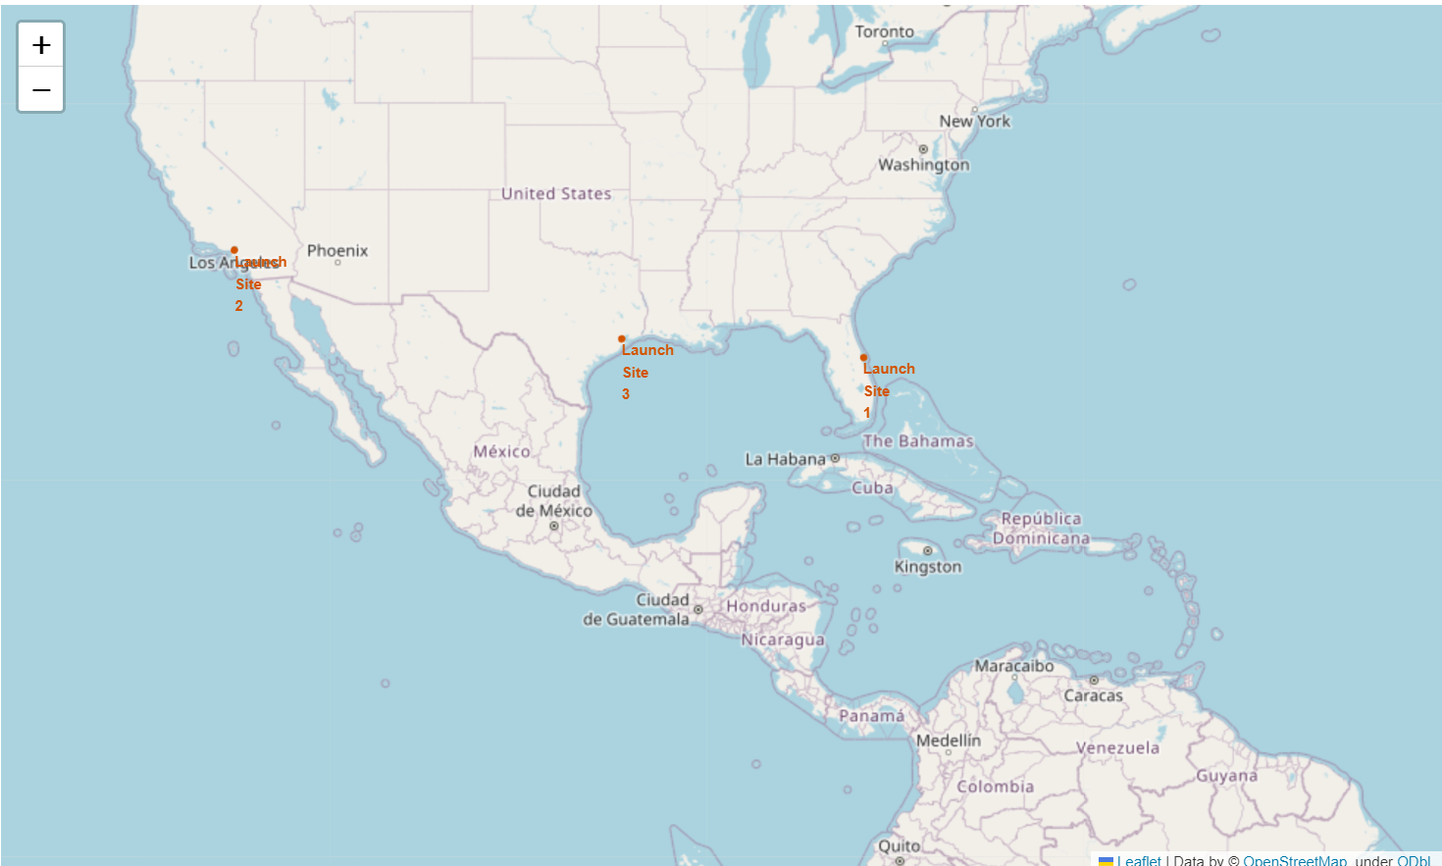
Interactive Map with Folium
Mark all launch sites on a map
https://github.com/selb76143/testrepo/blob/main/IBM-DS0321EN-SkillsNetwork_labs_module_3_lab_jupyter_launch_site_location.jupyterlite.ipynb

Slide 34
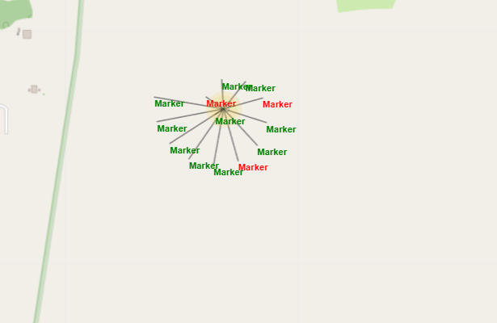
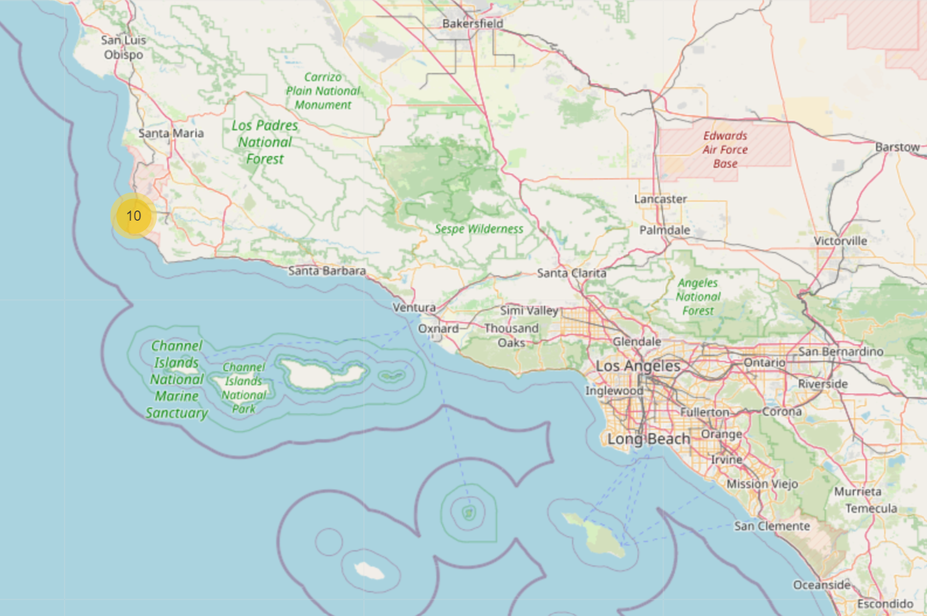
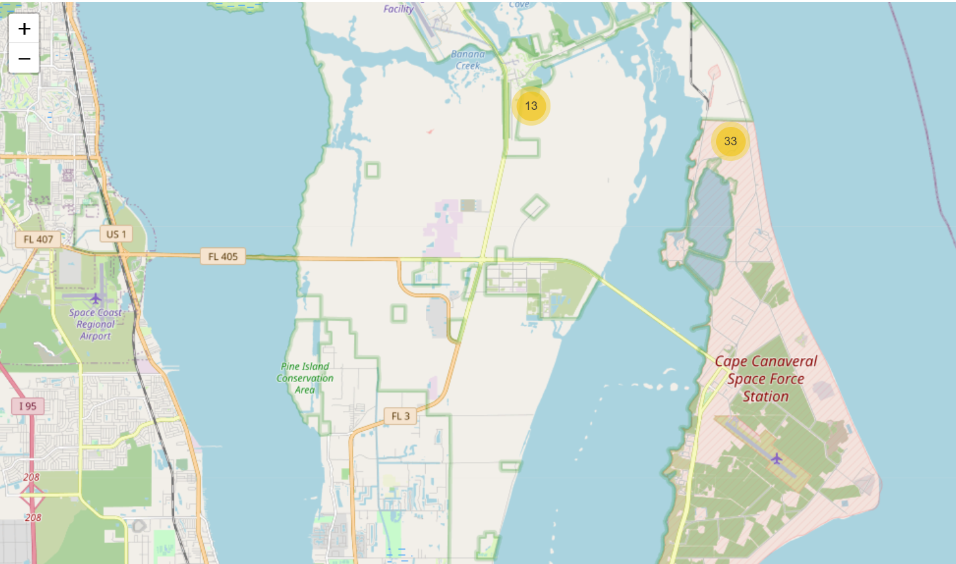
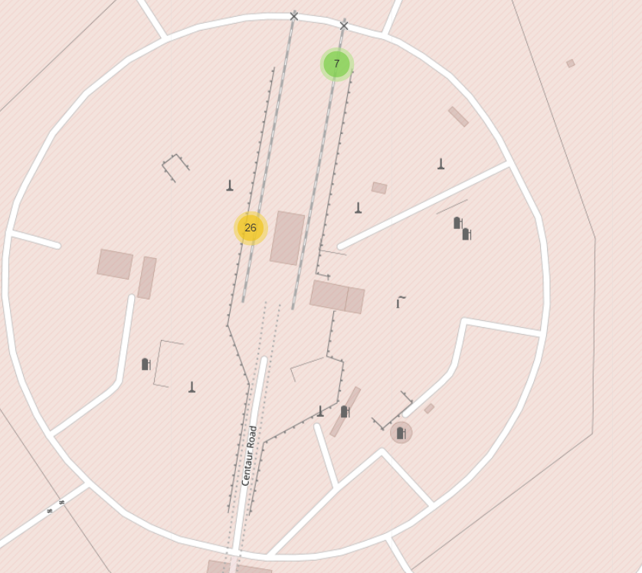
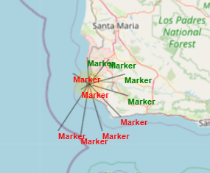
Interactive Map with Folium
Mark the success/failed launches for each site on the map

Slide 35

Section 4

Slide 36
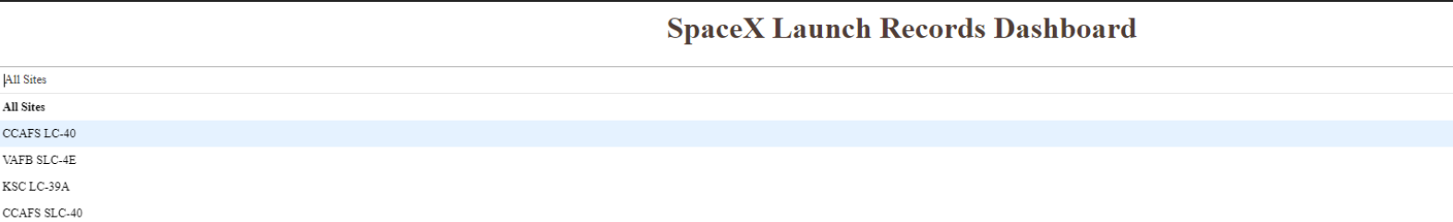
Dashboard with Plotly Dash
Add a Launch Site Drop-down Input Component
https://theiadocker-2-labs-prod-theiak8s-4-tor01.labs.cognitiveclass.ai/user/jenselby2001/#/home/project

Slide 37
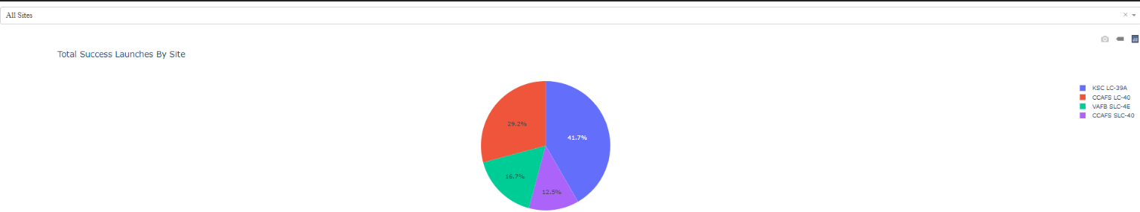
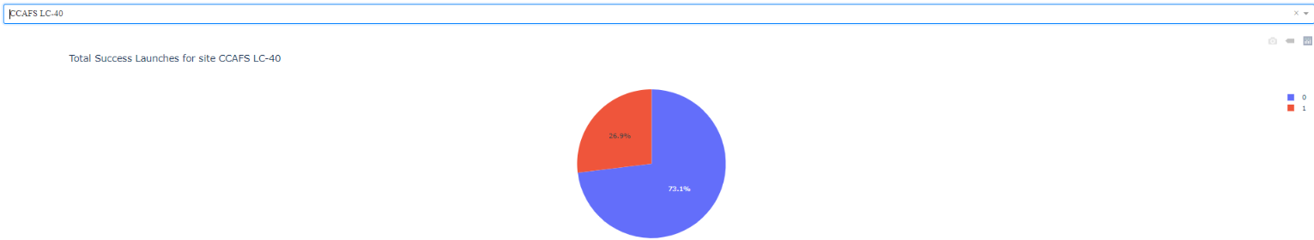
Dashboard with Plotly Dash
Add a callback function to render success-pie-chart based on selected site dropdown
KSC LC-39A had the most successful launches of all sites
KSC LC-39A had the most successful launches of all sites: 77%

Slide 38
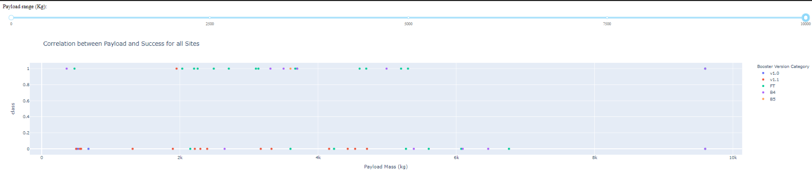
Dashboard with Plotly Dash
Add a Range Slider to Select Payload
Add a callback function to render the success-payload-scatter-chart scatter plot
Higher success rate for low payload mass

Slide 39

Section 5

Slide 40
Classification Accuracy
The methodology outlined above was repeated for SVM, KNN and Decision Tree
Logistic Regression: 82.2% Accuracy | SVM: 82.2% Accuracy
KNN: 84.4% Accuracy | Decision Tree: 88.9% Accuracy

Slide 41
Classification Accuracy
Decision tree model has the highest accuracy
Main challenge is false positives: unsuccessful predicted as successful

Slide 42
Conclusions
Increased launch success rate is positively correlated with
Increased number of flights for a given launch site
KSC LC-39A site had the highest success rate of all sites
Decreased payload mass
CCAFS SLC 40 site had most instances of lower payload mass
Increased instances of ES-L1, GEO, HEO and SSO orbits
Flights occurring from 2013 to 2022
Successful prediction of launch outcome is most positively correlated with
Use of the decision tree machine learning algorithm
Able to distinguish between different classes of flights: successful/unsuccessful
Main challenge is false positives: unsuccessful predicted as successful

Slide 43


